Slide 1
Clusters in Chaos: A Deep Unsupervised Learning Paradigm for Network Anomaly Detection
Krishnaa S (2020506045) Jawahar A S (2020506035) Thamizharasi M (2020506102)
Under the guidance of
Dr. P. Kola Sujatha

Slide 2
PROBLEM STATEMENT
With the ever-increasing sophistication of cyberattacks, traditional security measures are struggling to keep pace, leaving networks vulnerable to disruptions, data breaches, and financial losses. Hence, an intelligent system capable of detecting anomalous network behaviour is crucial for identifying these threats before they can cause significant damage.

Slide 3
OBJECTIVES
Analyse and understand the NSL KDD dataset.
Develop a deep unsupervised learning model.
Optimize the clustering techniques and evaluate the model.

Slide 4
LITERATURE SURVEY
SNo | Description | Pros and Cons
1 | ARCADE: Adversarially Regularized Convolutional Autoencoder for Network Anomaly Detection Published in: IEEE Transactions on Network and Service Management , IEEE Year: 2023 Authors: Willian Tessaro Lunardi, Martin Andreoni Lopez, Jean-Pierre Giacalone About: ARCADE, an unsupervised deep learning detection system for network anomaly detection. ARCADE uses a convolutional Autoencoder to build a profile of normal traffic and detect potential anomalies and intrusions efficiently. | Advantages: --ARCADE is better at finding unusual things in computer networks --It's faster and more accurate than other methods. --Works well using much fewer computer resources Disadvantages: --Designed mainly for finding problems in computer networks. --Can be challenging as it needs a lot of computer strength
2 | A Deep Learning Approach to Network Intrusion Detection Published in: IEEE Transactions on Emerging Topics in Computational Intelligence Year: 2018 Authors: Willian Tessaro Lunardi, Martin Andreoni Lopez, Jean-Pierre Giacalone. About: Utilizes TensorFlow to implement a Deep Belief Network (DBN) for efficient network anomaly detection, tackling challenges in Network Intrusion Detection Systems (NIDS). It introduces Non-Symmetric Dimensionality Auto-Encoder (NDAE) for enhanced feature learning, outperforming DBNs, and employs stacked NDAE with Random Forest for superior classification. | Advantages: --Introduces a new method for intrusion detection in modern networks. --Proposes NDAE for better feature learning and classification. --Presents a classification model using stacked NDAEs, combining deep and shallow learning. --Implemented and evaluated on GPU-enabled TensorFlow --used KDD Cup '99 and NSL-KDD datasets. Disadvantages: --Excludes attack patterns with less than 20 occurrences. --Dataset Limitations.

Slide 5
LITERATURE SURVEY
SNo | Description | Pros and Cons
3 | Clustering and Unsupervised Anomaly Detection with l2 Normalized Deep Auto-Encoder Representations Published in: 2018 International Joint Conference on Neural Networks (IJCNN), IEEE Year: 2018 Authors: Caglar Aytekin; Xingyang Ni; Francesco Cricri; Emre Aksu About: Uses l2 normalization in auto-encoder training to enhance clustering and anomaly detection by improving accuracy. The method adds this constraint, boosting accuracy in grouping information. The computer learns from dense or convolutional layers and minimizes errors during training for better results. | Advantages: --Outperforms other deep anomaly detection methods using reconstruction error. --Demonstrates superior performance compared to methods relying on reconstruction error. Disadvantages: --Effectiveness depends on data complexity and distribution, limiting generalizability. --Sensitivity to hyperparameter choice during training may require additional experimentation and tuning.
4 | Unsupervised Detection of Anomalous Running Patterns Using Cluster Analysis Published in: 2023 IEEE 13th International Conference on Electronics and Information Technologies (ELIT) Year: 2023 Authors: Ivan Ursul; Andriy Pereymybida About: Examines methods for finding unusual patterns in groups, covering different techniques like distance-based, hierarchical, and density-based approaches. It also talks about using teamwork (ensemble) and spotting outliers to get better at finding unusual things in a specific dataset. | Advantages: * The paper provides a comprehensive review of anomaly detection algorithms for clustering applications. * The authors have applied different cluster-based algorithms to a customer dataset to detect anomalies and compared their performance based on scalability, precision, recall, and F1 score metrics. Disadvantages: * The paper may have a limited scope in terms of the datasets used for experimental evaluation. * The paper may not provide real-world application examples or case studies to demonstrate the practical implementation and effectiveness of the proposed method in real-world scenarios.

Slide 6
LITERATURE SURVEY
SNo | Description | Pros and Cons
5 | Detecting Network Transmission Anomalies using Autoencoders-SVM Neural Network on Multi-class NSL-KDD Dataset Published in: 2023 IEEE 13th Annual Computing and Communication Workshop and Conference (CCWC) Year: 2023 Authors: Shehram Sikander Khan; Akalanka Bandara Mailewa About: Examines methods for finding unusual patterns in groups, covering different techniques like distance-based, hierarchical, and density-based approaches. It also talks about using teamwork (ensemble) and spotting outliers to get better at finding unusual things in a specific dataset. | Advantages: * The proposed AEN-based supervised GCN model effectively addresses both volumetric attacks and long-term threats in network security. * The approach demonstrates promising accuracy scores when evaluated using real-world datasets. Disadvantages: *The paper does not compare the performance of the proposed detection model against benchmark models. * The evaluation is limited to two specific datasets, and the generalizability of the approach to other datasets is not explored.

Slide 7
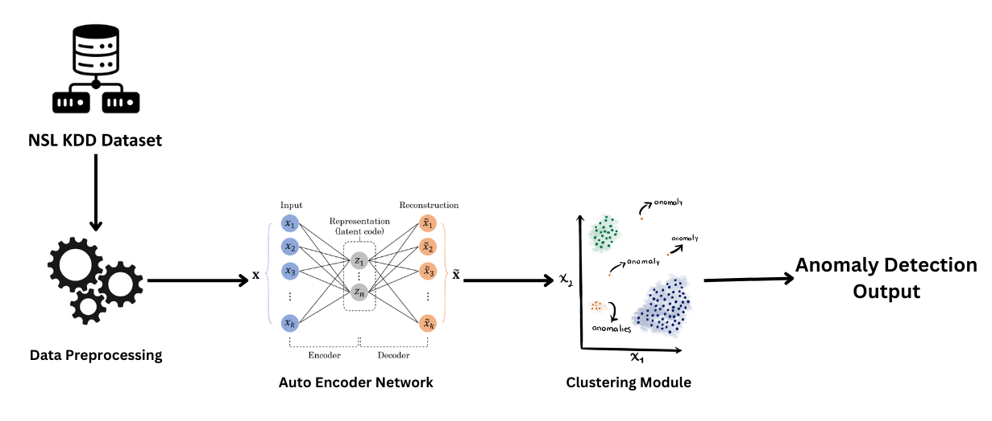
ARCHITECTURE DIAGRAM

Slide 8
MODULES
Module 1: Dataset exploration, Analysis and Preprocessing
Explore dataset characteristics.
Analyse and preprocess NSL-KDD dataset.
Implement data cleaning, scaling, and normalization.
Module 2: Autoencoder Model Development
Design deep autoencoder architecture.
Implement and train autoencoder model on pre-processed data.
Evaluate model using reconstruction error metrics.
Module 3: Anomaly Detection Using Reconstruction Comparison
Set up thresholding mechanism based on reconstruction error.
Determine criteria for identifying anomalies.

Slide 9
MODULES
Module 4: Clustering Integration
Choose and implement suitable clustering algorithms.
Fine-tune clustering parameters for optimal performance.
Module 5: Evaluation and Model Refinement
Evaluate the complete anomaly detection system using appropriate metrics.
Refine the model based on evaluation results.

Slide 10
BENIFITS
1. Early Detection of Security Threats: Enabling proactive responses to potential intrusions, unauthorized access, and malicious activities.
2. Swift Incident Response: Reduce response time to security incidents by swiftly identifying and classifying abnormal network patterns.
3. Improved Operational Resilience: Mitigate issues such as congestion, performance degradation, and service disruptions, ensuring a more robust and reliable network infrastructure.
4. Resource Optimization and Efficiency: Aids in resource optimization by identifying and addressing bandwidth-hogging activities and other network resource misuses.

Slide 11
REFERENCES
W. T. Lunardi, M. A. Lopez and J. -P. Giacalone, "ARCADE: Adversarially Regularized Convolutional Autoencoder for Network Anomaly Detection," in IEEE Transactions on Network and Service Management, vol. 20, no. 2, pp. 1305-1318, June 2023, doi: 10.1109/TNSM.2022.3229706. keywords: {Anomaly detection;Training;Telecommunication traffic;Generative adversarial networks;Data models;Generators;Deep learning;Unsupervised anomaly detection;autoencoder;generative adversarial networks;automatic feature extraction;deep learning;cybersecurity},
N. Shone, T. N. Ngoc, V. D. Phai and Q. Shi, "A Deep Learning Approach to Network Intrusion Detection," in IEEE Transactions on Emerging Topics in Computational Intelligence, vol. 2, no. 1, pp. 41-50, Feb. 2018, doi: 10.1109/TETCI.2017.2772792. keywords: {Machine learning;Intrusion detection;Anomaly detection;Training data;Communication networks;Monitoring;Deep learning;anomaly detection;auto-encoders;KDD;network security},
C. Aytekin, X. Ni, F. Cricri and E. Aksu, "Clustering and Unsupervised Anomaly Detection with l2 Normalized Deep Auto-Encoder Representations," 2018 International Joint Conference on Neural Networks (IJCNN), Rio de Janeiro, Brazil, 2018, pp. 1-6, doi: 10.1109/IJCNN.2018.8489068. keywords: {Training;Anomaly detection;Neural networks;Image reconstruction;Encoding;Clustering algorithms;Clustering methods},
I. Ursul and A. Pereymybida, "Unsupervised Detection of Anomalous Running Patterns Using Cluster Analysis," 2023 IEEE 13th International Conference on Electronics and Information Technologies (ELIT), Lviv, Ukraine, 2023, pp. 148-152, doi: 10.1109/ELIT61488.2023.10310751. keywords: {Performance evaluation;Wearable computers;Scalability;Clustering algorithms;Network intrusion detection;Optics;Telemetry;clusters;anomaly detection;unsupervised learning},
S. S. Khan and A. B. Mailewa, "Detecting Network Transmission Anomalies using Autoencoders-SVM Neural Network on Multi-class NSL-KDD Dataset," 2023 IEEE 13th Annual Computing and Communication Workshop and Conference (CCWC), Las Vegas, NV, USA, 2023, pp. 0835-0843, doi: 10.1109/CCWC57344.2023.10099056. keywords: {Support vector machines;Training;Computational modeling;Neural networks;Predictive models;Feature extraction;Security;NSL-KDD;Network Security;Intrusion Detection System;Deep Autoencoders;Anomaly Detection;Support Vector Machine (SVM);t-SNE;Deep Learning},

Slide 12


